Slide 1
Spatial structure and movement in Stock Synthesis
Richard Methot & Ian Taylor
NMFS Northwest Fisheries Science Center

Slide 2
Stock Synthesis spatial options
Any number of areas
(limited by memory, speed)
Fleets are all area-specific
Area-specific growth patterns (optional)
Design matrix for movement between areas for each season, growth pattern
Global recruitment partitioned to areas
Uses generalized framework for parameters in SS (priors, time-varying options, etc.)

Slide 3
Design matrix for movement in Control file
4 #_N_movement_definitions
0 # first age that moves (real age at begin of season, not integer)
# seas,morph,source,dest,minage,maxage
1 1 1 1 1 10
1 1 1 2 1 10
1 1 2 2 5 20
1 1 2 3 5 20

Slide 4
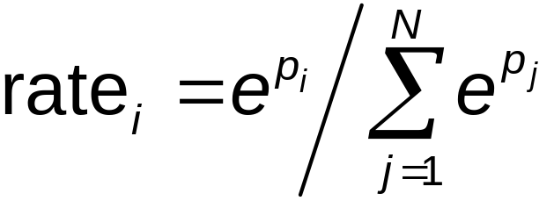
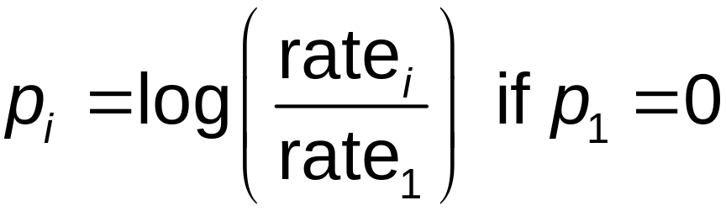
Movement parameters in Control file
Two parameters per movement definition to allow separate rates for old and young fish, with ramp in between (linear in log space)
Exponentiated and scaled to sum to 1.0:

Slide 5
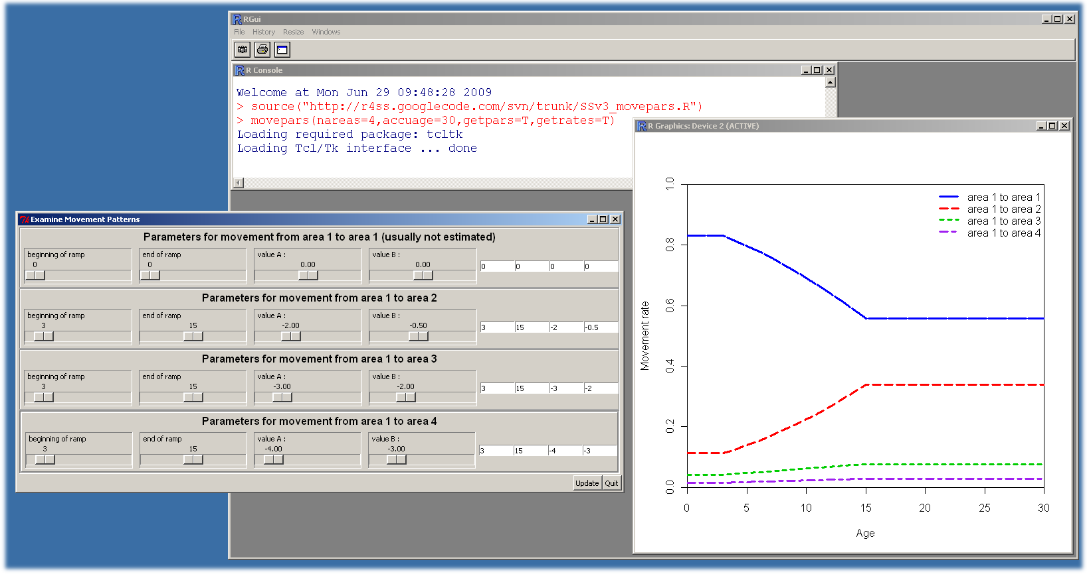
Movement rate parameterization
Widget for R to explore movement rates at http://code.google.com/p/r4ss/
Excel spreadsheet also available

Slide 6
Recruitment
Total global recruitment calculated from all areas, seasons, and growth patterns
Recruits assigned to these divisions according to apportionment weights (estimated or fixed, constant or time-varying)
Tranformation of apportionment weight parameters to fractions is equivalent to calculation used for movement rates.

Slide 7
Simulation testing example making use of spatial options in Stock Synthesis

Slide 8
Example: ontogenetic movement
Simulation study to test ability of single area model with separate fleets to approximate spatial shift
Simulate using three spatial areas (shallow, middle, deep)
Apply single area models with different selectivities for each fleet
Compare estimated parameters and quantities of interest to simulated values

Slide 9
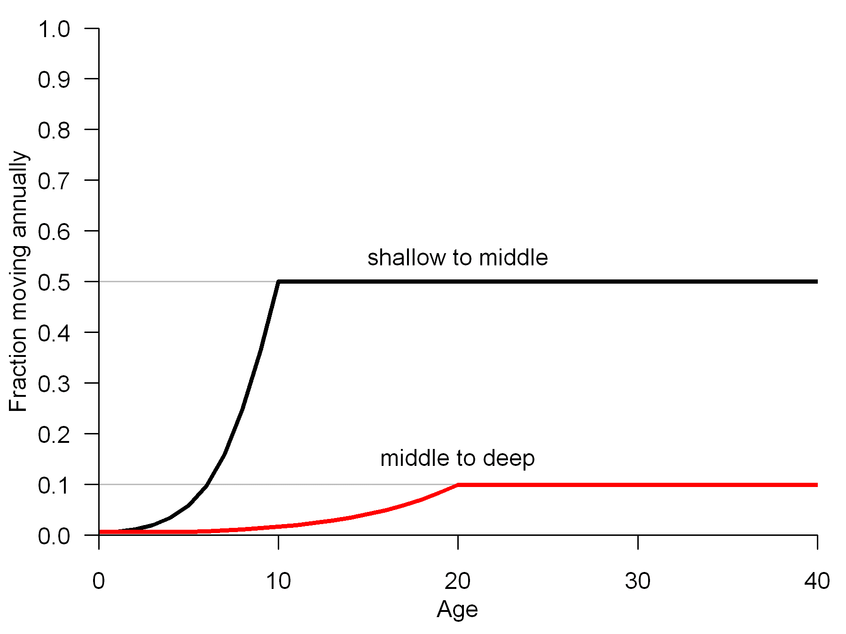
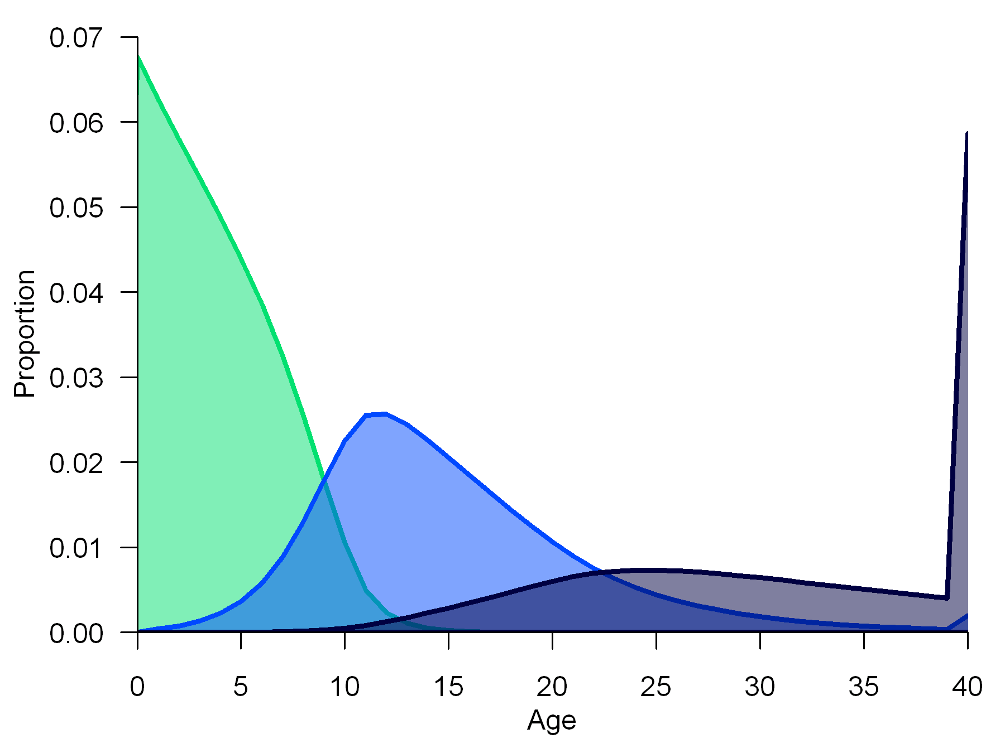
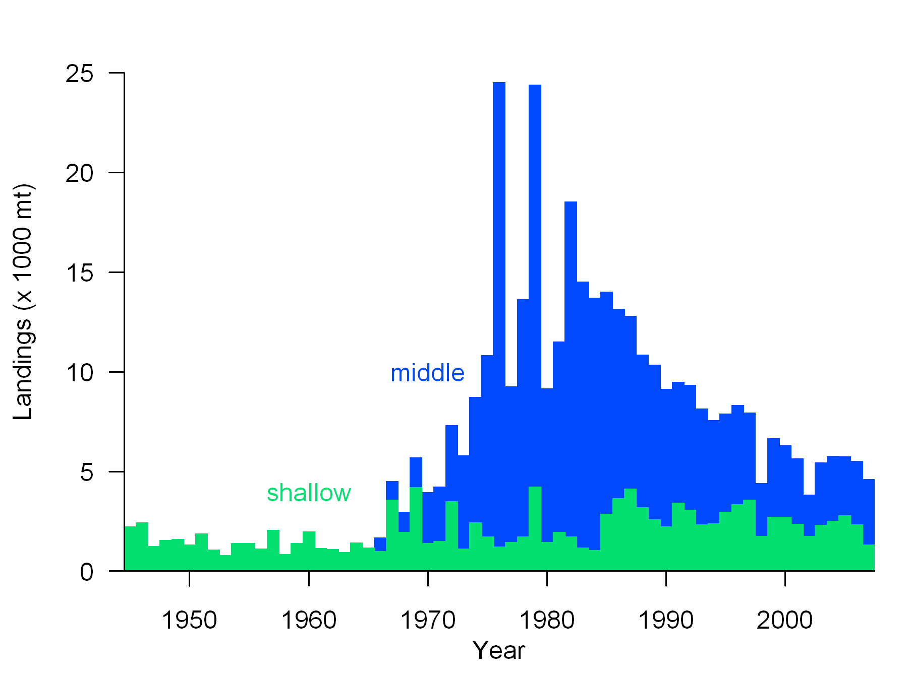
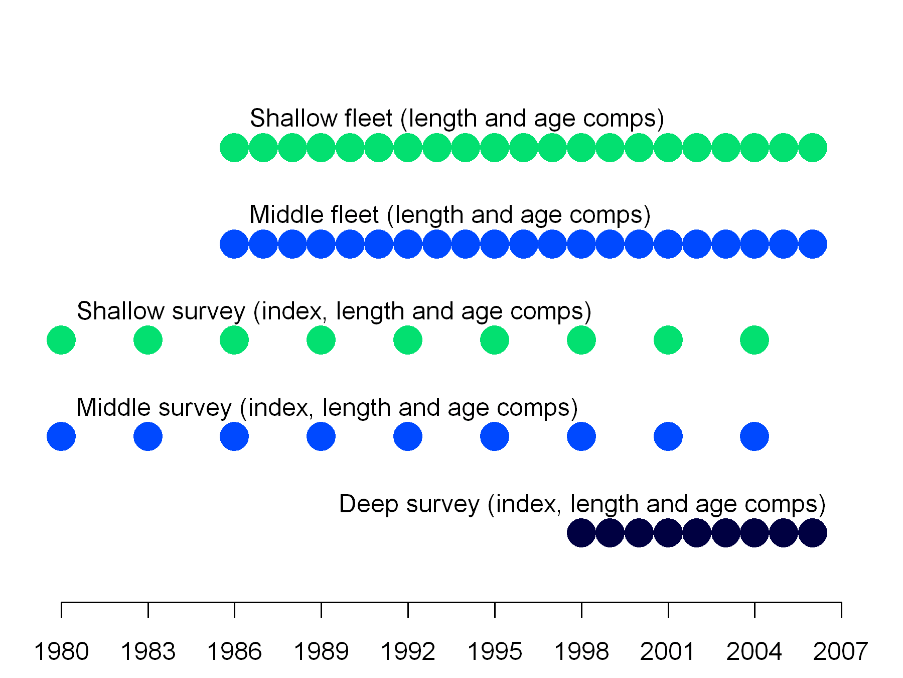
Simulation model configuration
movement rates equilibrium age comp
catch time series bootstrap data
shallow
area
middle
area
deep area

Slide 10
Estimation model configuration
In all cases estimated parameters are
  selectivity for each fleet,
  initial biomass,
  recruitment deviations from 1970-2007
Fitting 3 area operating model to itself with
logistic selectivity as a reference group
Fitting 1 area model with three selectivity arrangements:
  Length-based (double-normal)
  Age-based (double-normal)
  Both length- and age-based (all double-normal)

Slide 11
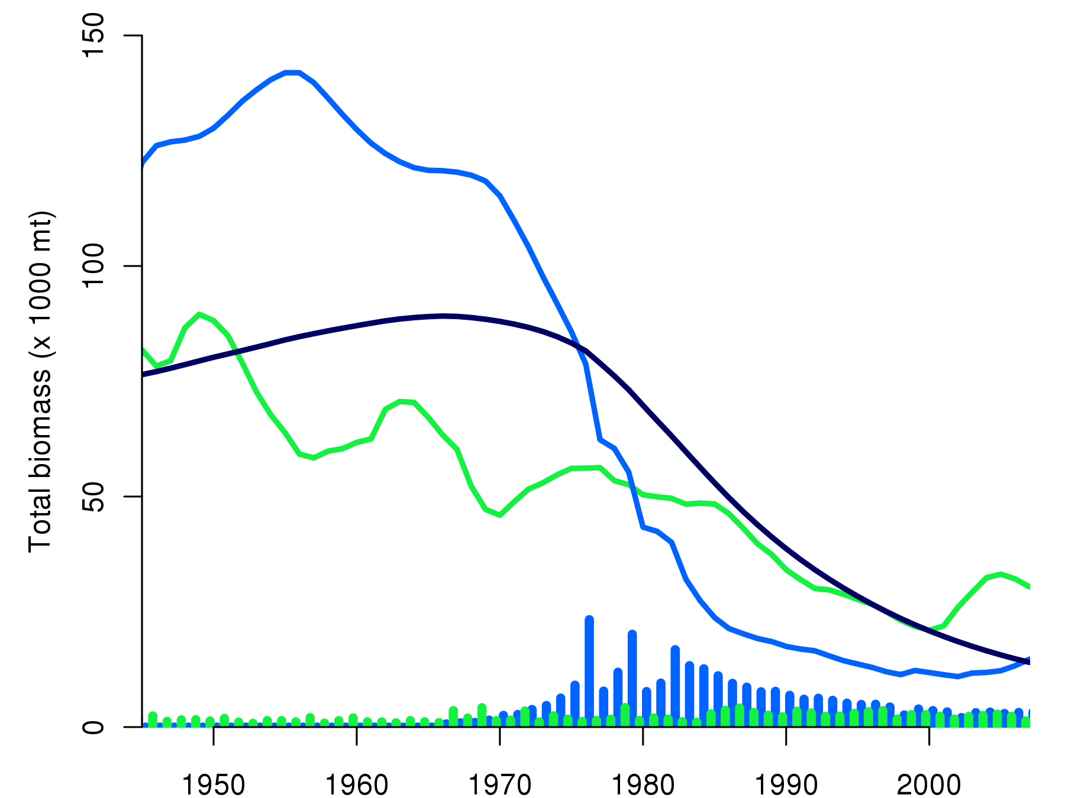
Example biomass trajectory
middle
area
deep area
shallow
area
catch in middle and deep areas

Slide 12
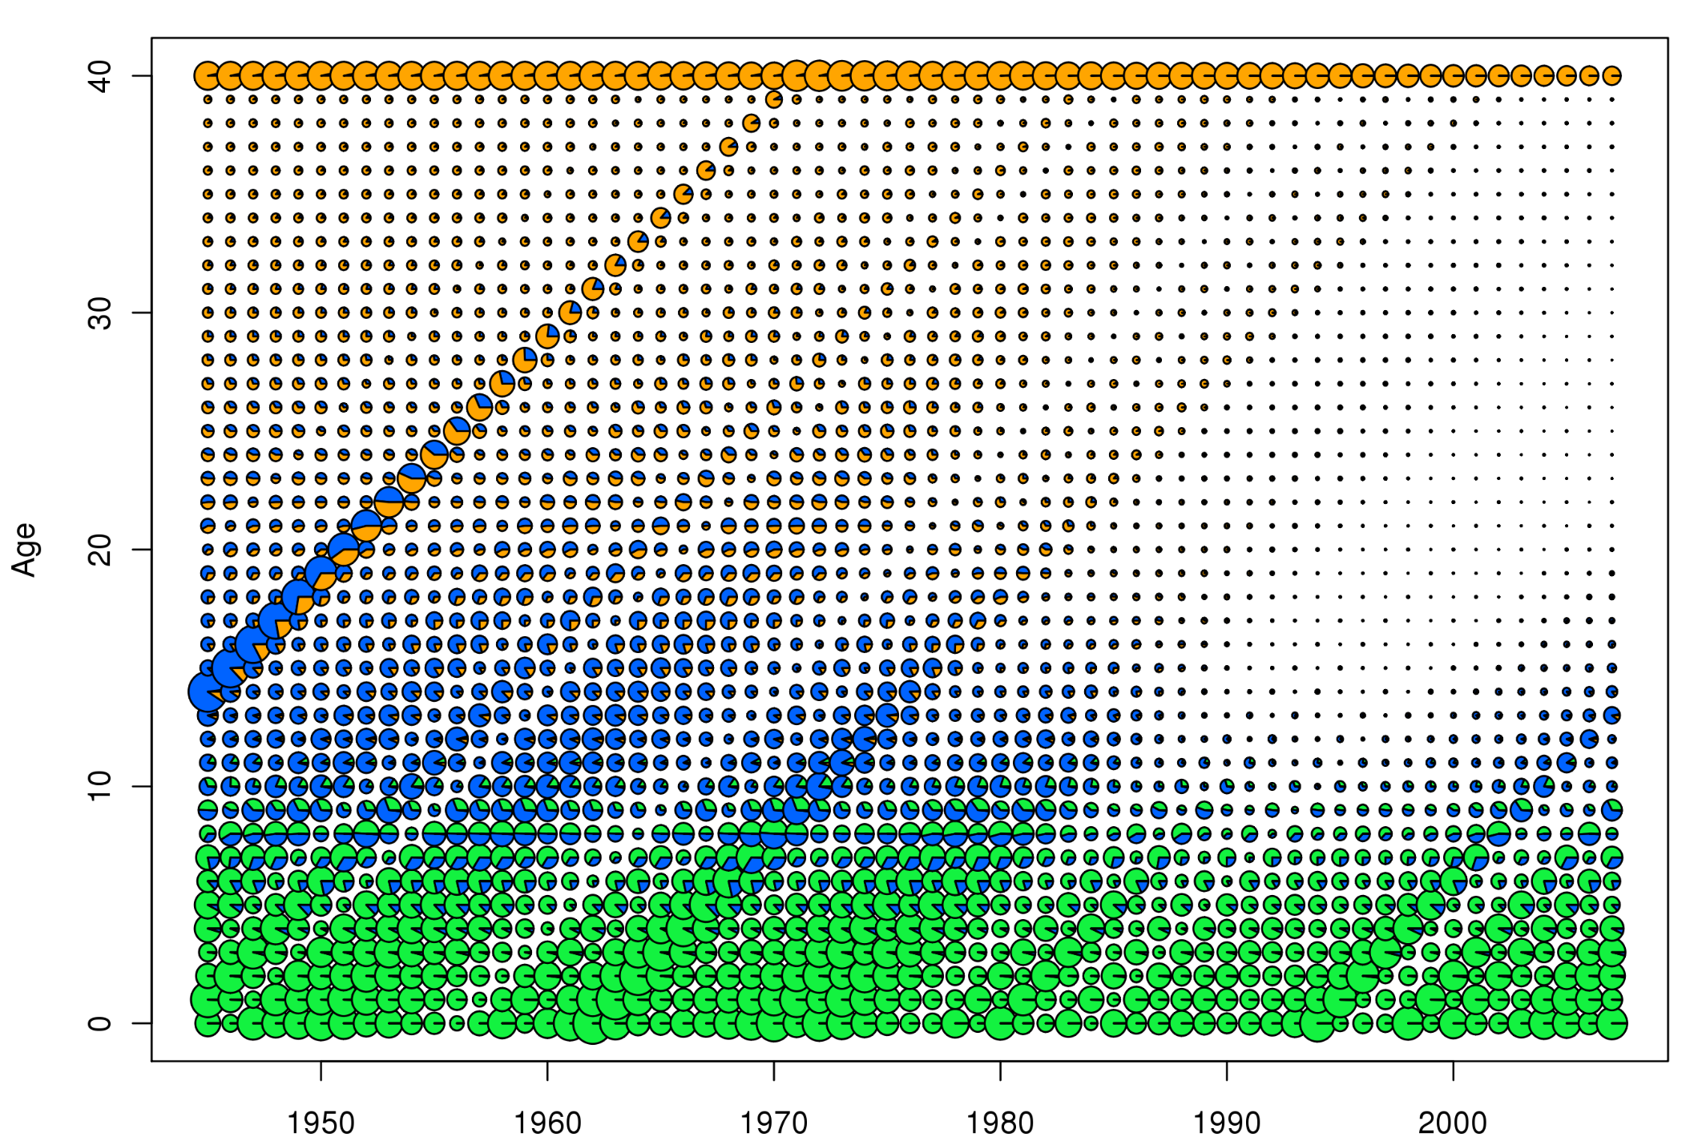
Example simulation: numbers at age
shallow area
middle area
deep area

Slide 13
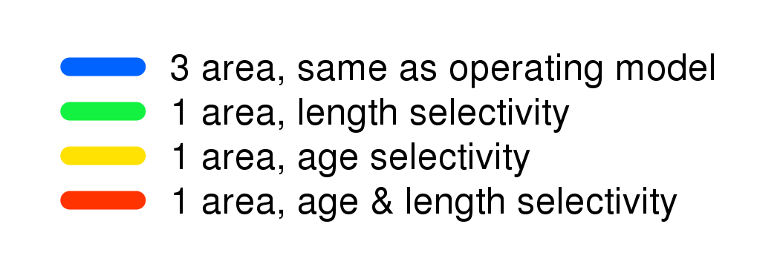
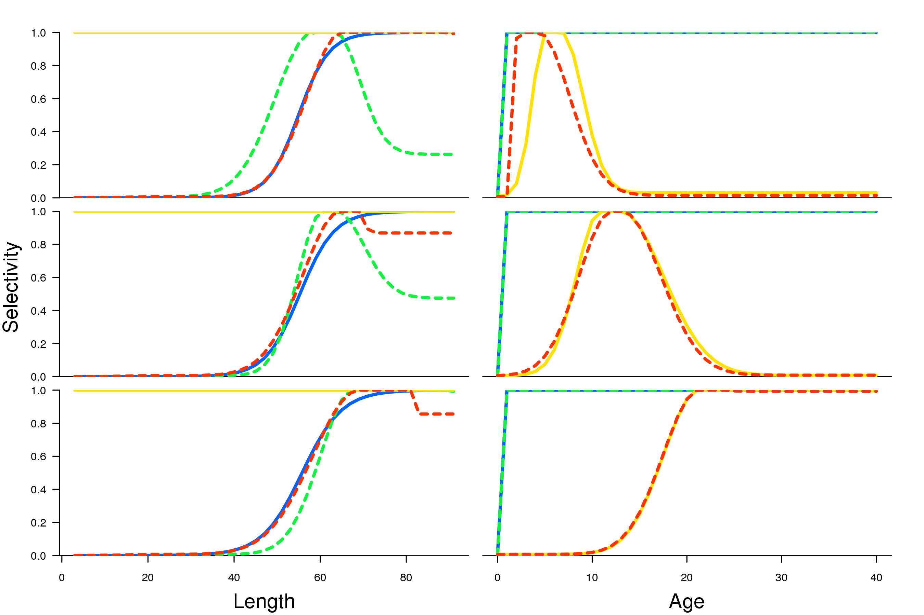
Estimated selectivities
shallow
survey
length
shallow
survey
age
middle
survey
length
middle
survey
age
deep
survey
length
deep
survey
age

Slide 14
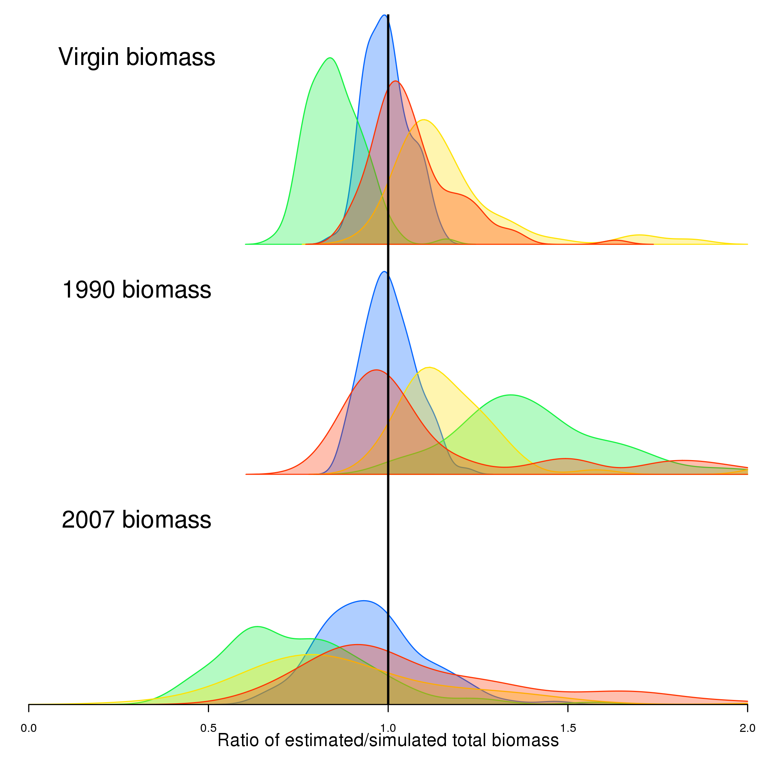
Biomass estimates

Slide 15
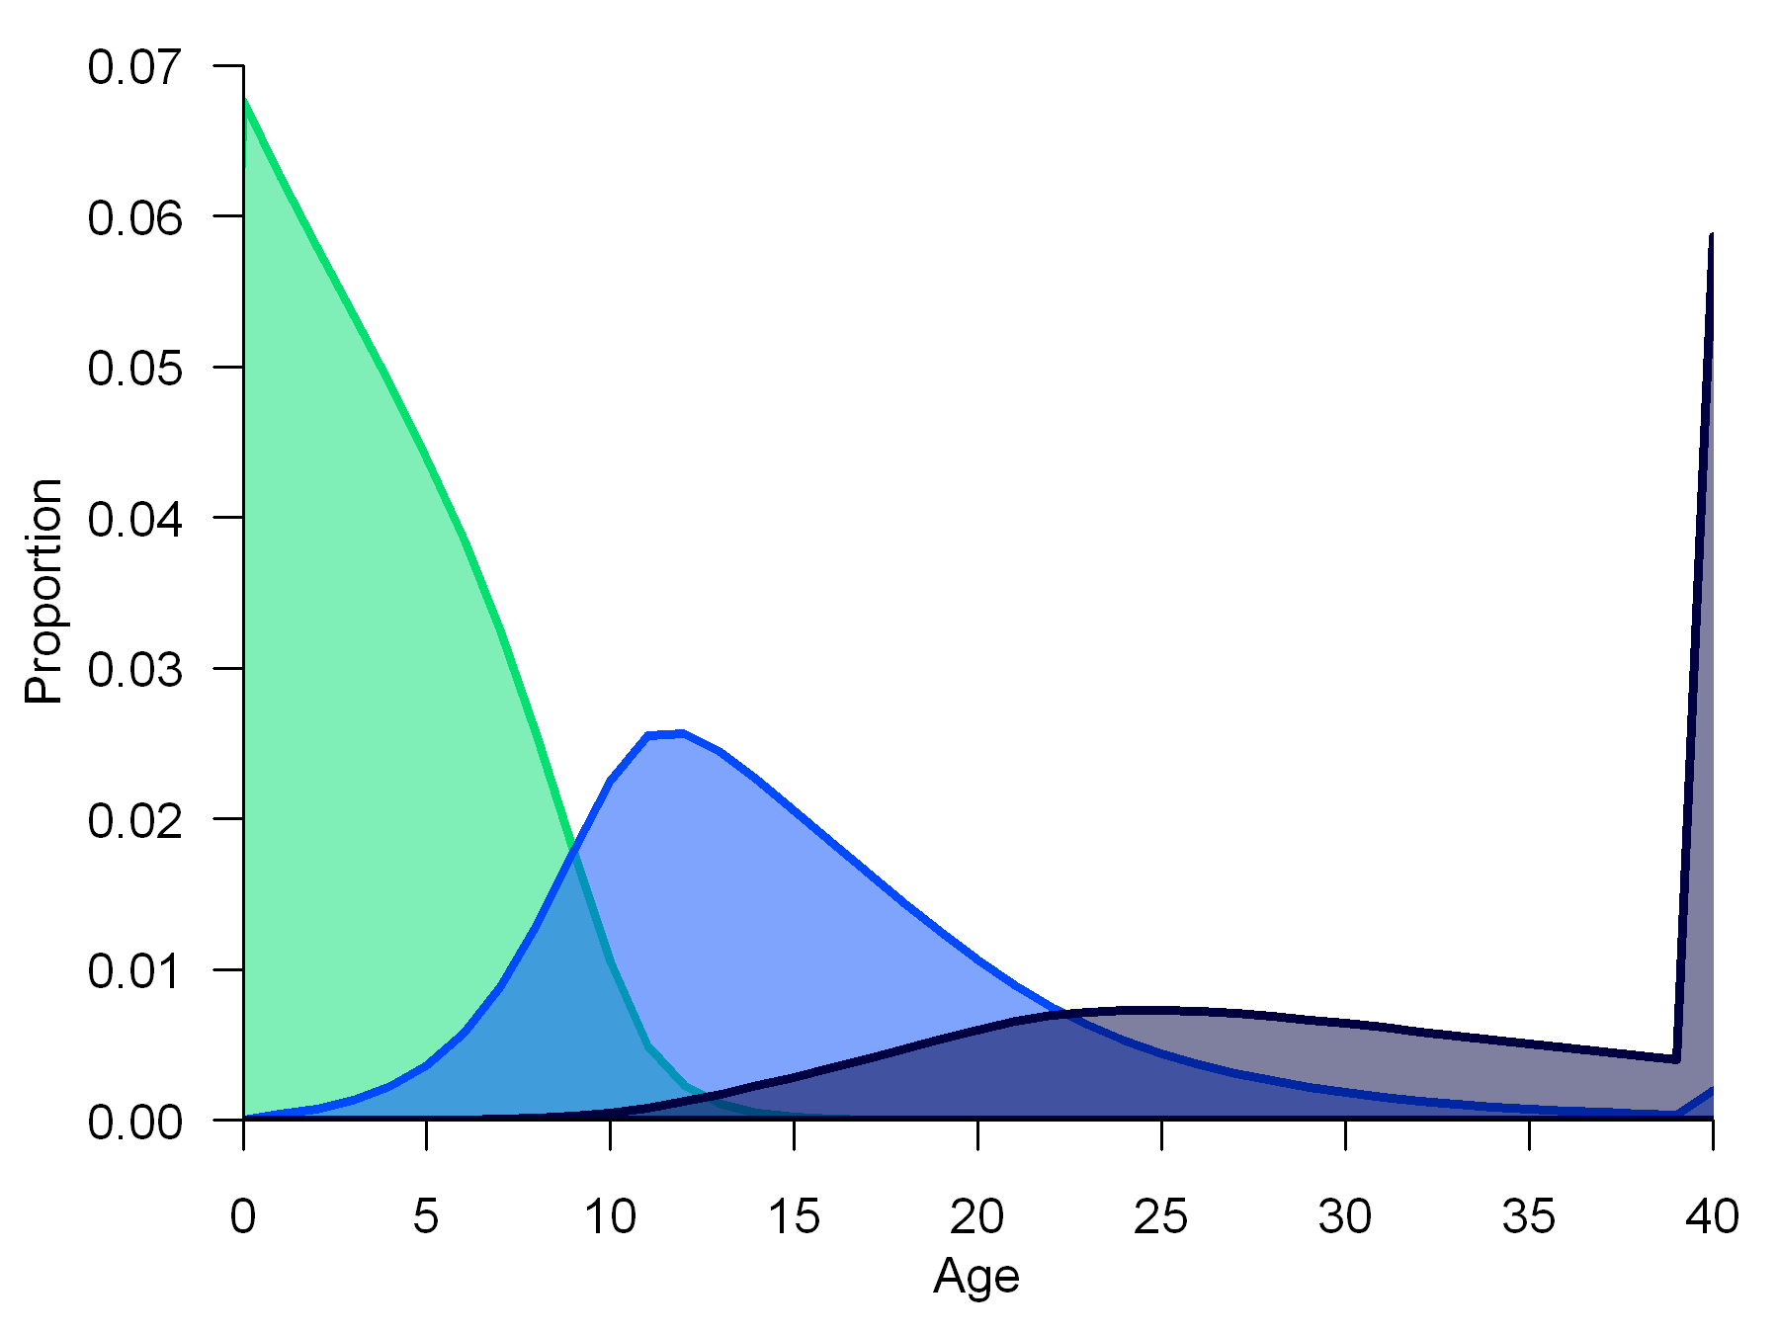
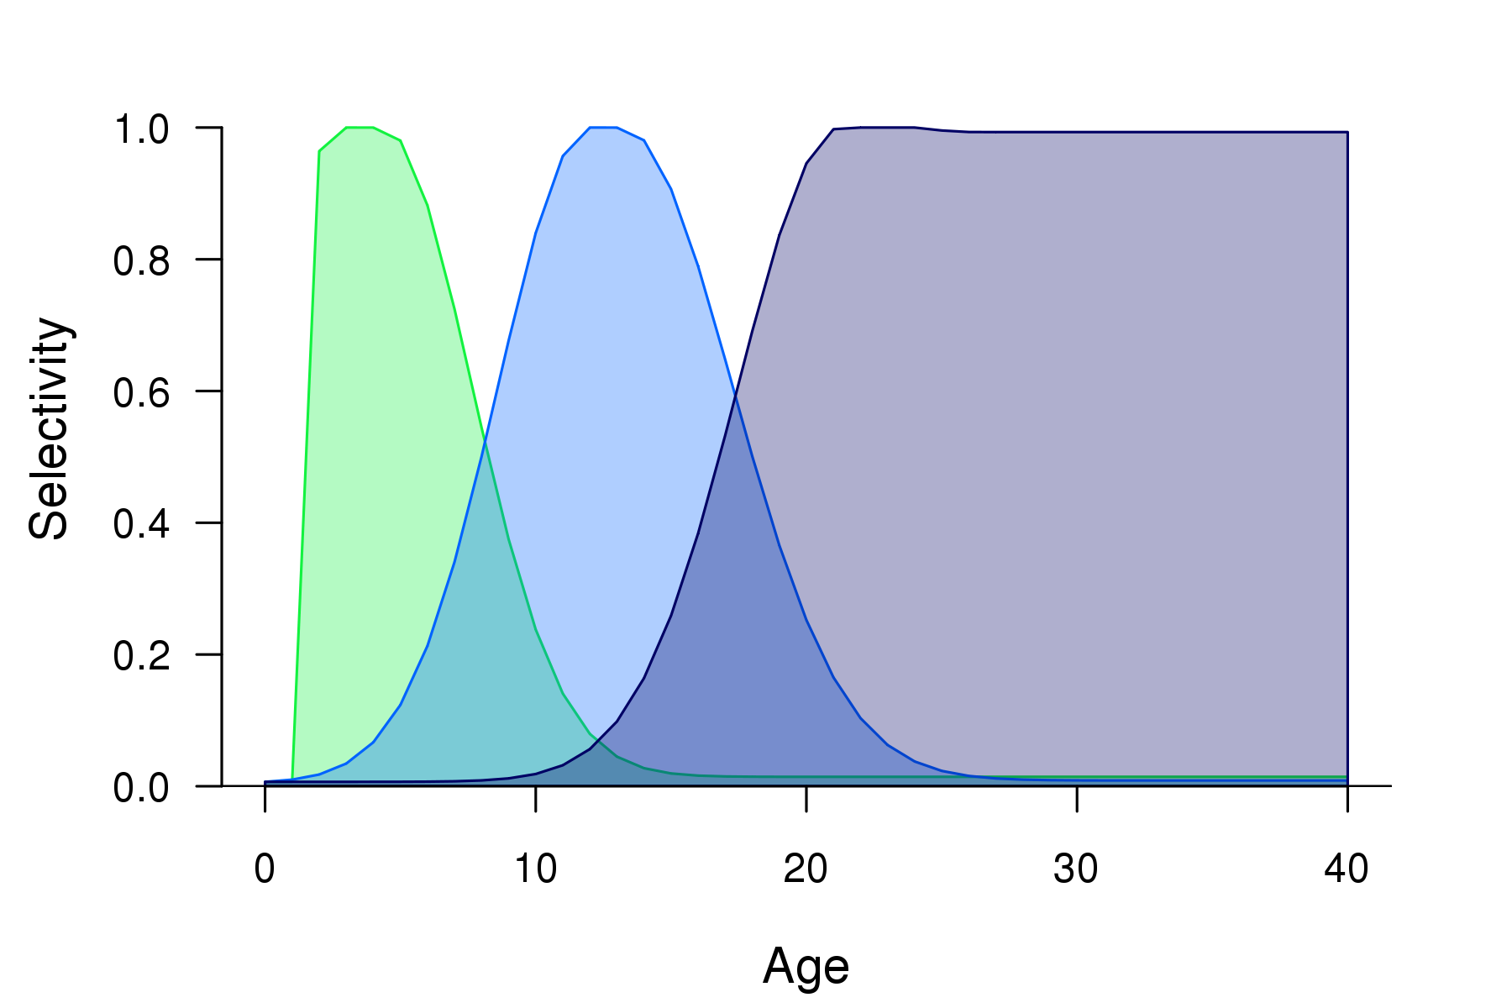
Age distribution revisited
shallow
area
Age distribution by
area from unfished
equilibrium population
in 3-area simulation
middle
area
deep area
Median estimated
age-based selectivity
from 1-area model
with age- and length-
based selectivity
deep survey
middle
survey
shallow
survey

Slide 16
Simulation model conclusions
Single area model with only length- or age-based selectivity does not perform well.
Single area model with selectivity as dome-shaped functions of both length and age shows less bias, but high variability.
Spatial model which matches generating model performs well.

